Slide 1
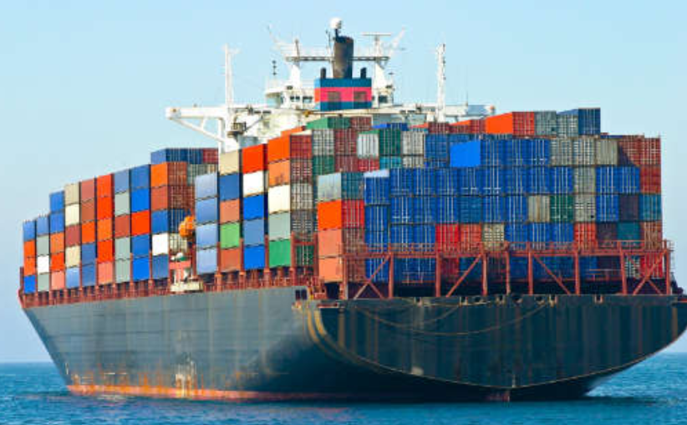
Getting Started with Docker

Slide 2
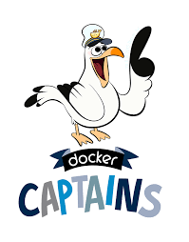



$whoami
Principal Development Engineer at DellEMC
1st half of my career was in CGI & VMware
2nd half of my career has been in System Integration Testing
Docker Captain (since 2016)
Docker Bangalore Meetup Organizer ( 8000+ Registered Users)
DockerLabs Incubator
Ajeet Singh Raina
Twitter: @ajeetsraina
GitHub: ajeetraina

Slide 3
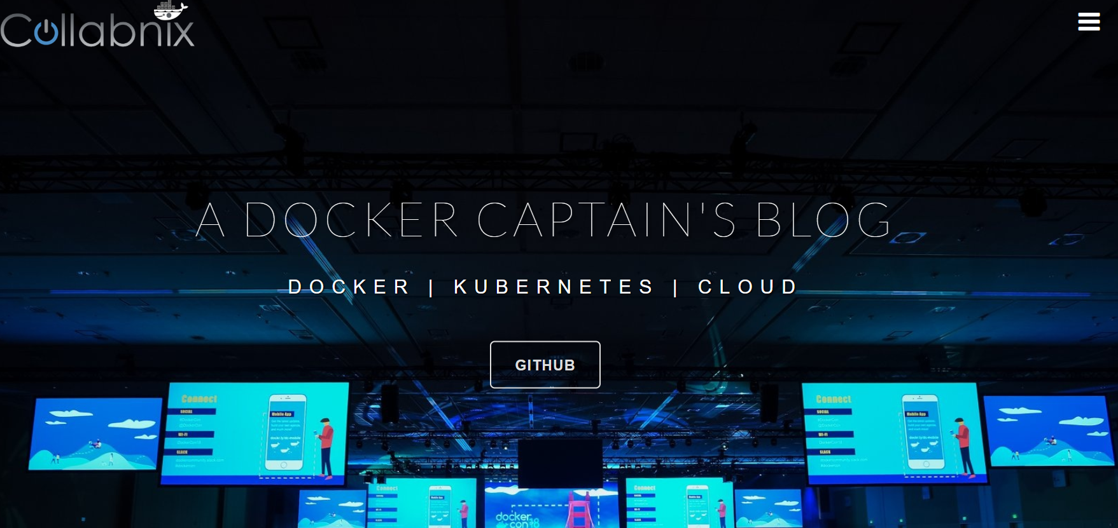
$curl www.collabnix.com
My Personal Blog website
Built on WordPress, Hosted on One.com
Recently Completed 4th Year
175+ blogs on Docker | Kubernetes | Cloud
Monthly close to 1 million visitors per month

Slide 4
Agenda
A Shift from Monolithic to Microservices Architecture
Traditional Software Development Workflow(with/without Docker)
What is Docker? What problem does it solve for us?
Docker Vs Linux Containers
Docker Vs Virtual Machine
Docker Underlying Technology
Running Your First Docker Container - Demo
Using Docker: Build, Ship and Run Workflow - Demo
Building Your Docker Image using Dockerfile – Demo
Introduction to Docker Compose – Demo
Docker Workshop

Slide 5
A Shift from Monolithic to Microservice Architecture

Slide 6
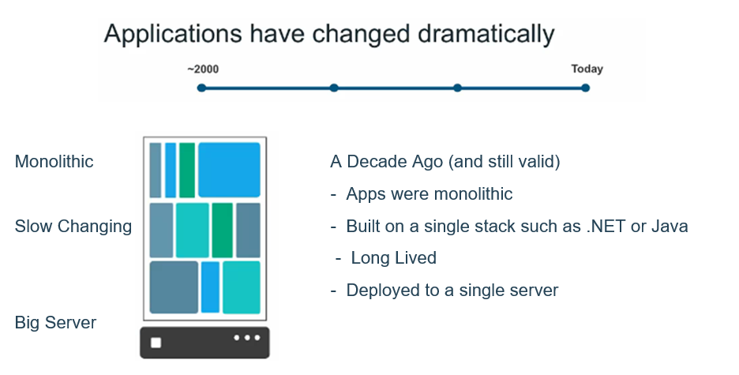

Slide 7
Let’s imagine you are building a large, complex application, e.g., Online Store

Slide 8
Successful Software Development
Architecture
Process
Organization

Slide 9
Successful Software Development
Architecture
Process
Organization
Small
Autonomous
team

Slide 10
Successful Software Development
Architecture
Process
Agile
Continuous Delivery
Organization
Small
Autonomous
team

Slide 11
Successful Software Development
Architecture
Monolthic Vs Microservices
Process
Agile
Continuous Delivery
Organization
Small
Autonomous
team

Slide 12
A Close Look at Monolithic
Storefront UI Module
Browser
HTML
Catalog
Module
Database
Client App
Reviews
Module
REST/JSON
Orders
Module
Notes:
Here’s my online store. As you can see its layered and modular. We have presentation layer exposing RESTAPI. Whenever the customer visit online store through browser in terms of HTML where he wants to just access the website OR might want to fetch information via RESTAPI.. There are various modules which implements different pieces of business functionality.

Slide 13
A Close Look at Monolithic
WAR
Storefront UI Module
Browser
HTML
Catalog
Module
Database
Client App
Reviews
Module
REST/JSON
Orders
Module
Tomcat
Notes:
But when we use monolithic approach, we package them up as a single application. Just a big monolithic application. IN Java world it would be WAR file.. The application uses a database. Inside Del, most of the application which we built has this architecture.

Slide 14
Benefits of Monolith
Simple to Develop, Test, Deploy & Scale
Simple to develop because of all the tools and IDEs support to that kind of application by default.
Easy to deploy because all components are packed into one bundle.
Easy to scale the whole application.

Slide 15
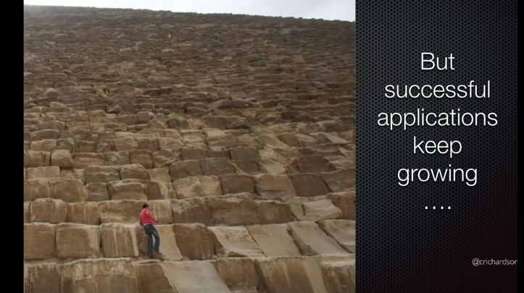

Slide 16
Disadvantages of Monolith
Very difficult to maintain
One component failure will cause the whole system to fail.
Very difficult to understand and create the patches for monolithic applications.
Adapting to new technology is very challengeable.
Take a long time to startup because all the components need to get started.
Notes:
Now online store became popular and grew with million of code

Slide 17
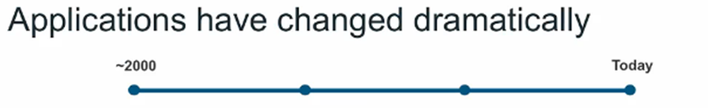




Customer/
Clients/ Users
Today
Apps are constantly developed
Built from loosely coupled components
Newer version are deployed often
- Deployed to a multitude of servers
Data Storage
Data Storage
Data Storage

Slide 18
Microservice Architecture
Storefront UI
Catalog
Service
Catalog Database
REST
HTML
API Gateway
Browser
REST
Reviews
Service
Reviews
Database
Order
Service
Order
Database
REST
Mobile Device
…
Service
…
Database
Notes:
What we saw previously as a single stack application now become standalone, composable services

Slide 19
Benefits of Microservices
Can scale independent microservices separately. No need to scale the whole the system
Can use the latest technologies to develop the microservices.
One component failure will not cause entire system downtimes.
When developing an overall solution we can parallel the microservices development task with the small teams. So it helps to decrease the development time.

Slide 20
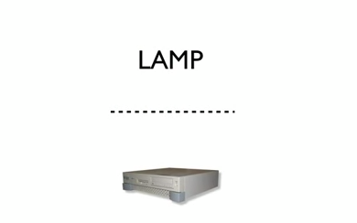
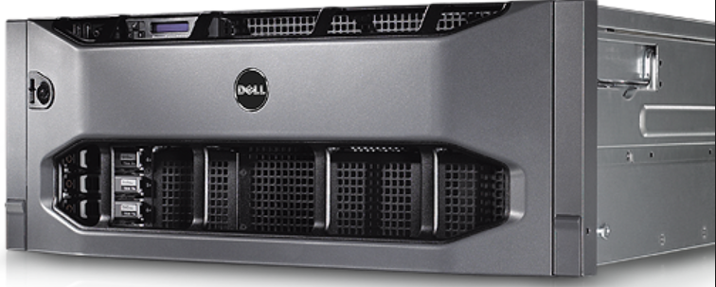
Once upon a time…a Software Stack

Slide 21
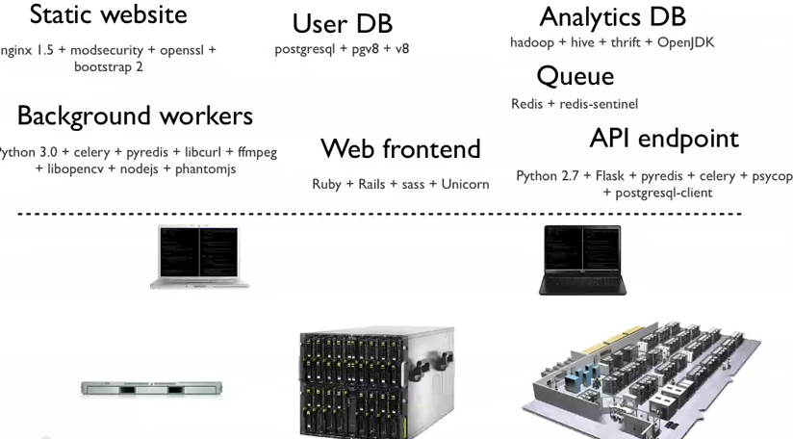
Now much more distributed & complex…

Slide 22
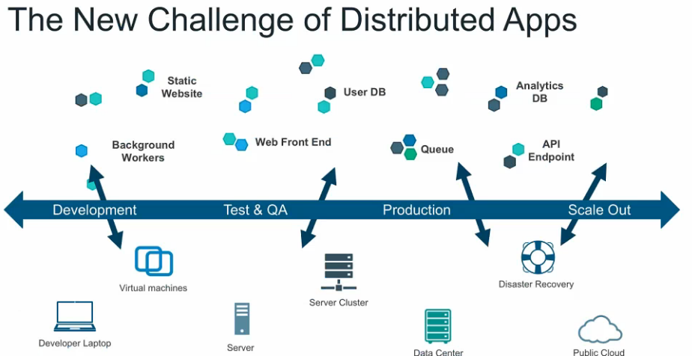

Slide 23
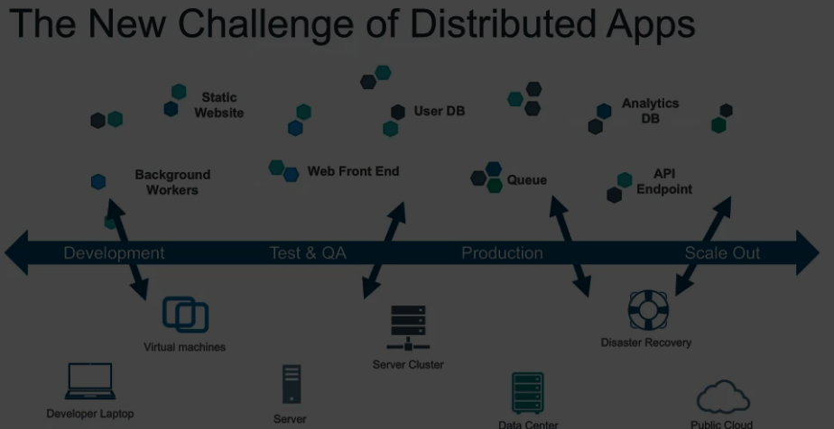
Shipping Code is damn too hard

Slide 24
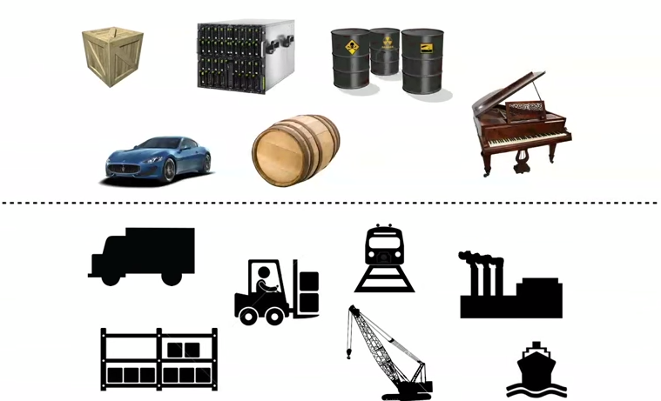
An Effort to solve the problem Complexity

Slide 25
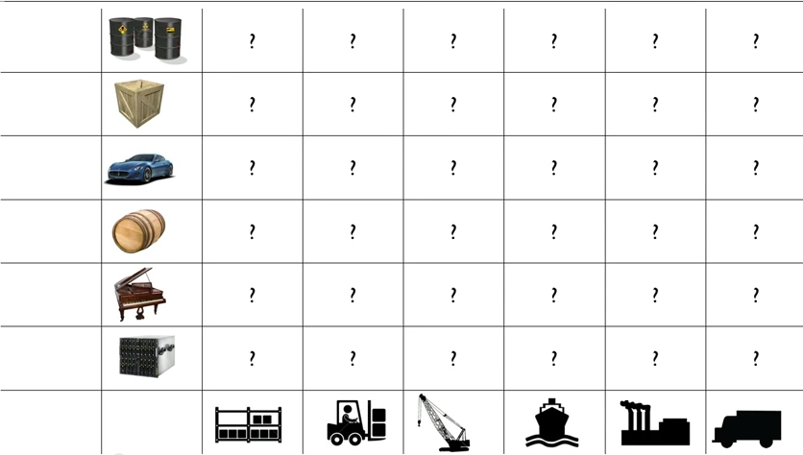
Every possible good to ship X Every Possible way to Ship

Slide 26
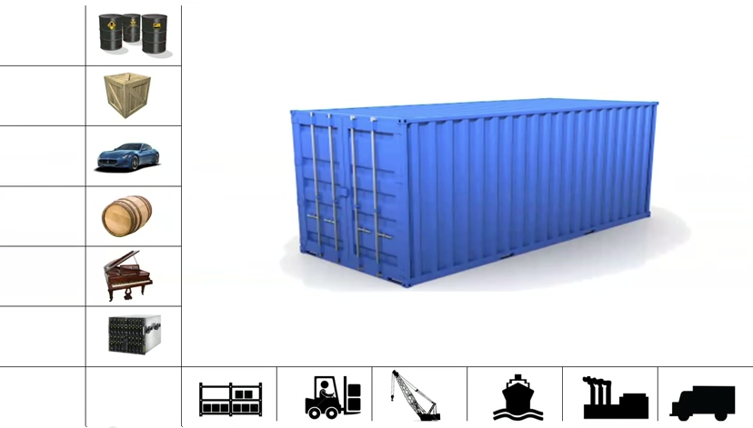
Enter….Internodal Container

Slide 27
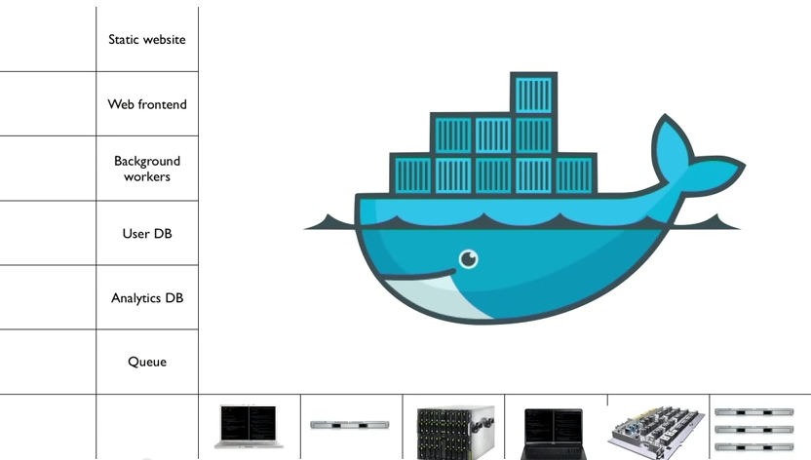
That’s what Docker is all about..

Slide 28
What is Docker and what problem does it solve?

Slide 29
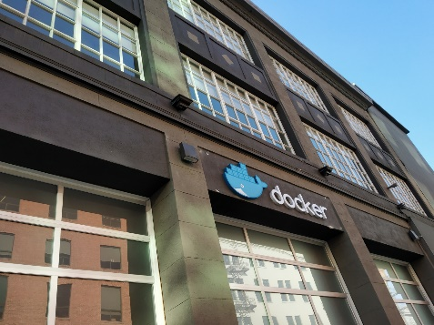

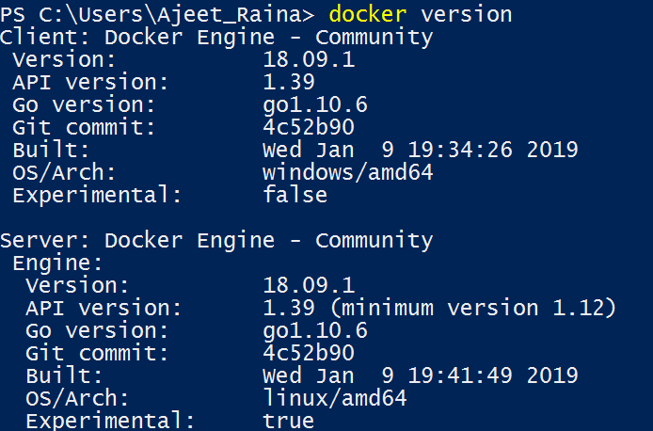
What is Docker?
Refers to several things in 2019
Docker as a “Company”
Docker as a “Product”
Docker as a “Platform”
Docker as a “CLI Tool”
Docker as a “Computer Program”

Slide 30
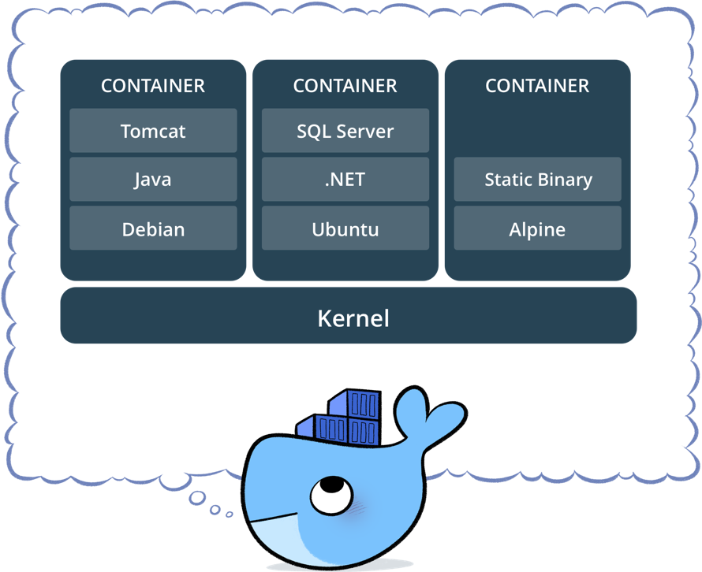
What is Docker?
Standardized packaging for software and dependencies
Isolate apps from each other
Share the same OS kernel
Works for all major Linux distributions
Containers native to Windows Server 2016 & 1809

Slide 31
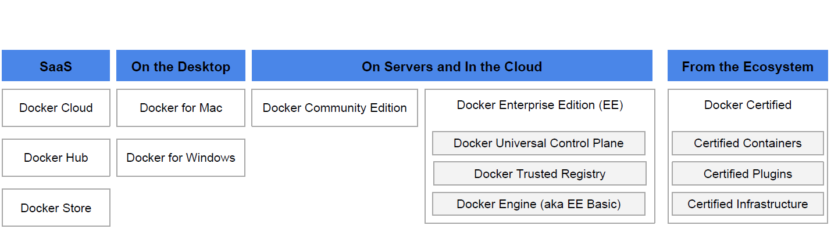

Docker Product Offerings

Slide 32
History of Docker
A Company as well as Product – 6 Years Old company
Developed by DotCloud Inc. ( Currently Docker Inc.)
A Framework they built their PaaS upon.
Released it as open source 3 and 1/2 years back
Cross-platform nature and friendliness towards System Admin and Developers
Possible to set up in any OS, be it Windows, OSX, Linux, Solaris - It work the same way
Guaranteed to run the same way - Your development desktop, a bare-metal server, virtual machine, data center, or cloud

Slide 33
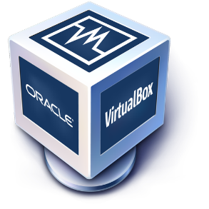
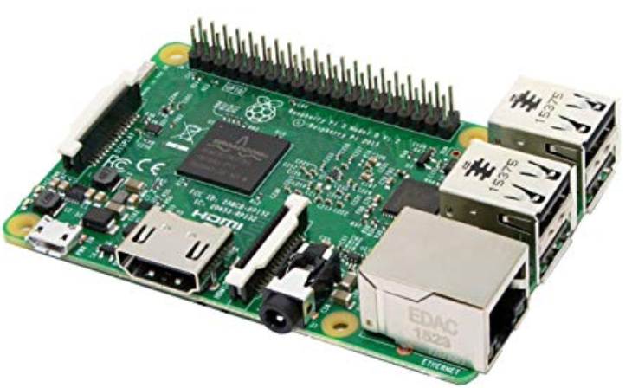
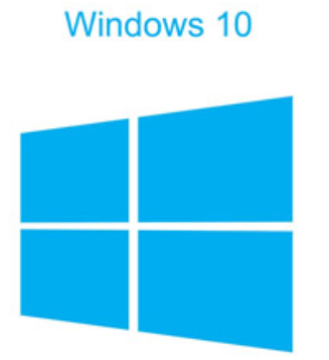
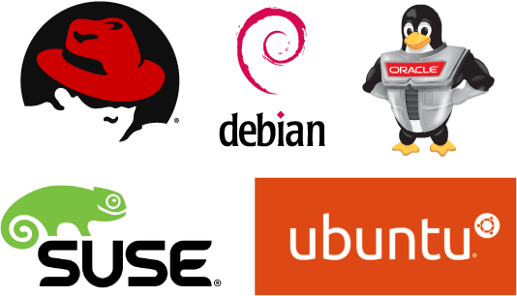

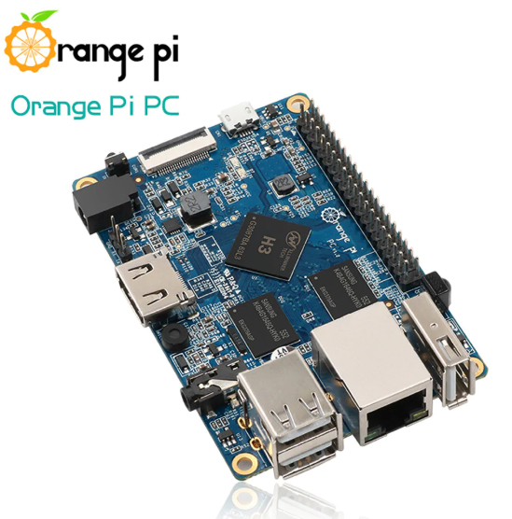

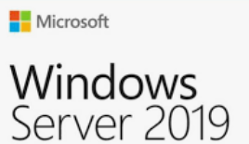



Today Docker runs on

Slide 34
Traditional Software Development WorkFlow
(without Docker)

Slide 35
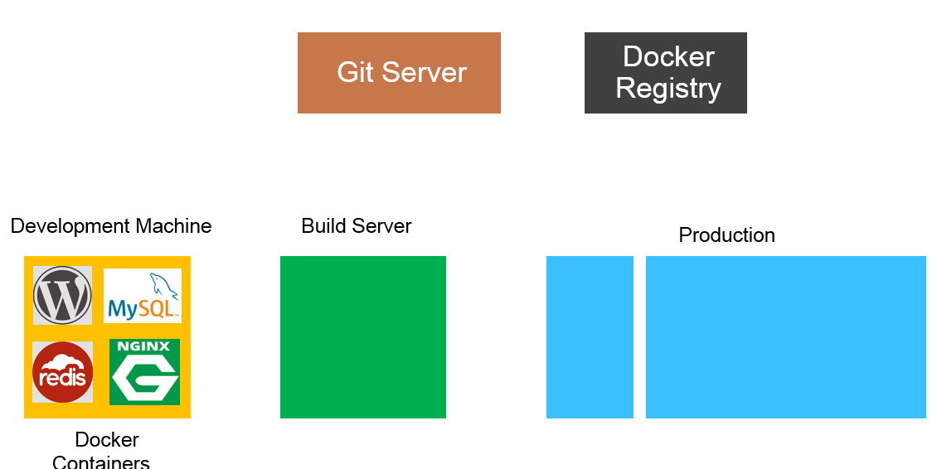


Slide 36
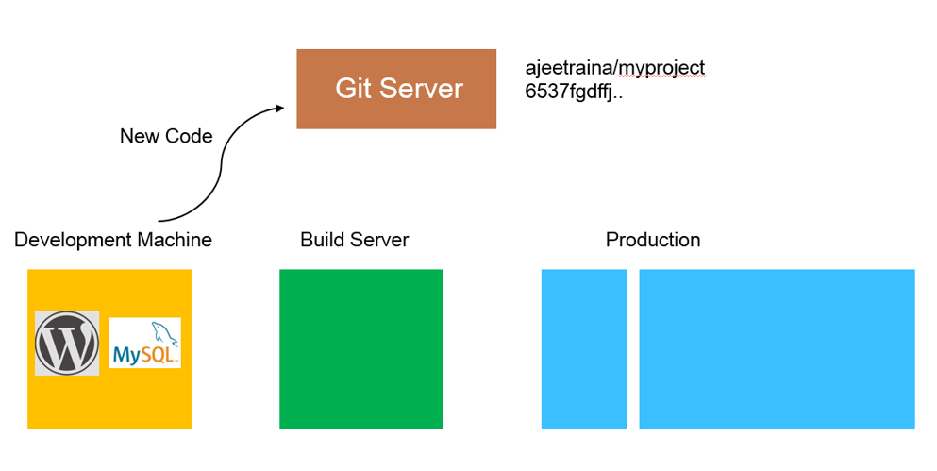

Slide 37
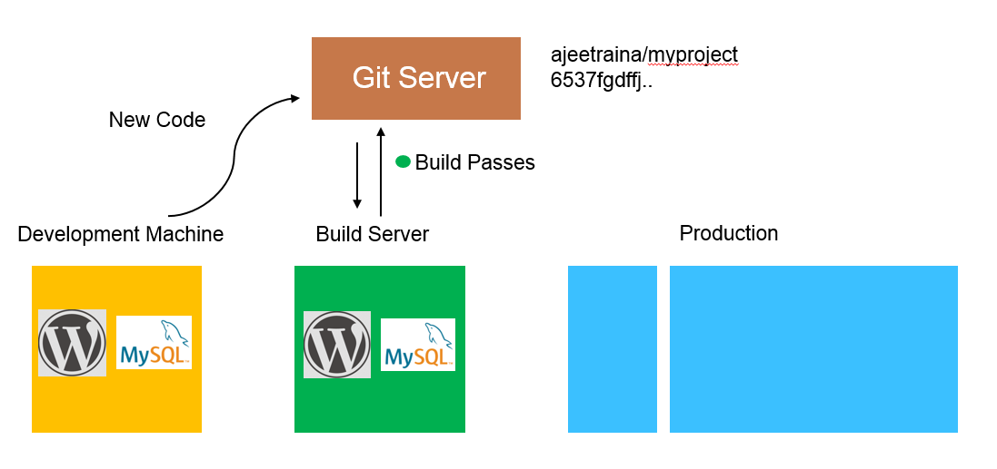

Slide 38
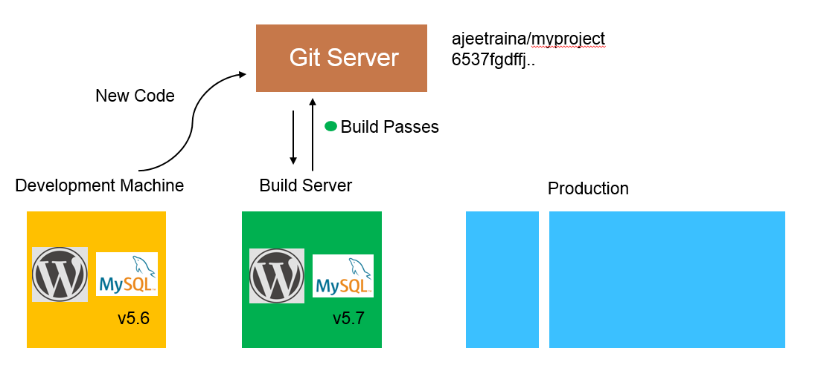

Slide 39
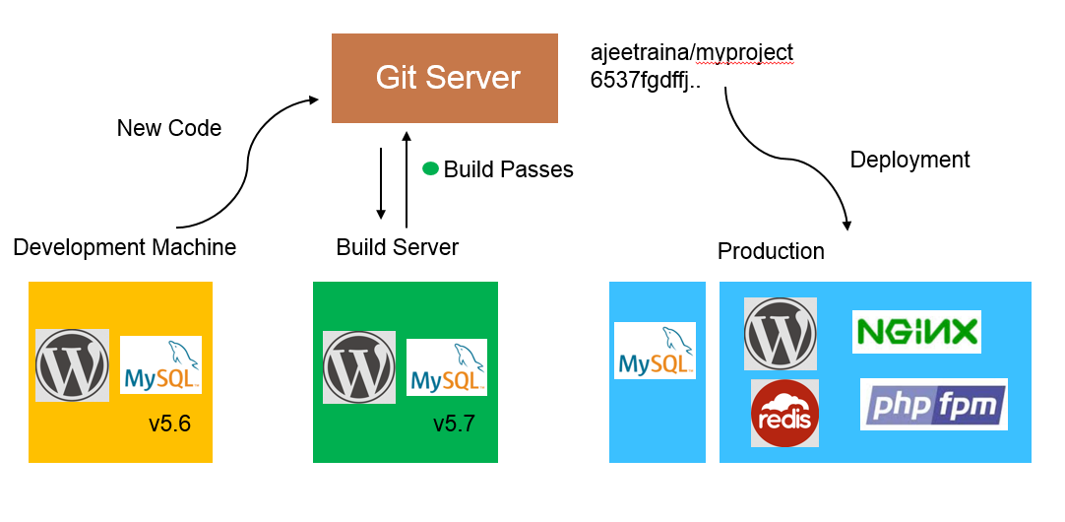

Slide 40
Traditional Software Development WorkFlow
(with Docker)

Slide 41
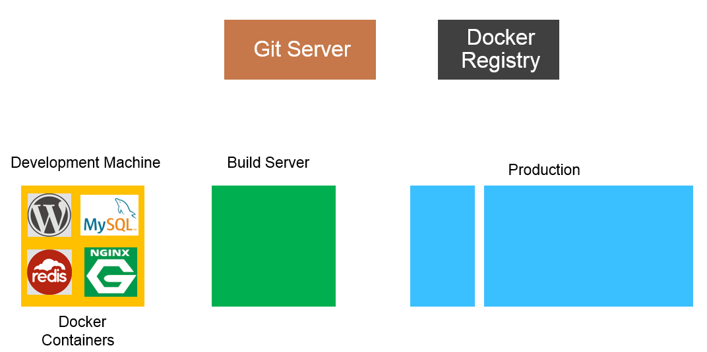

Slide 42
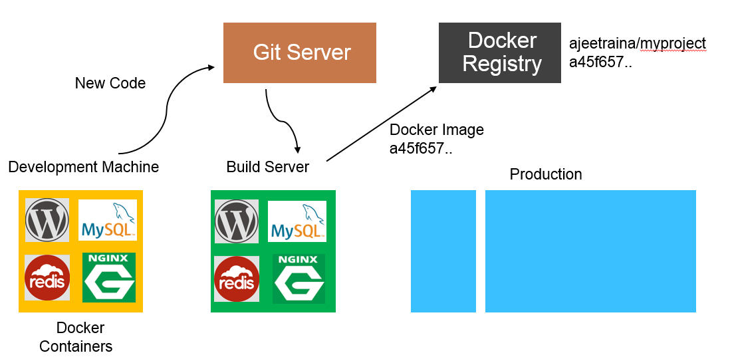

Slide 43
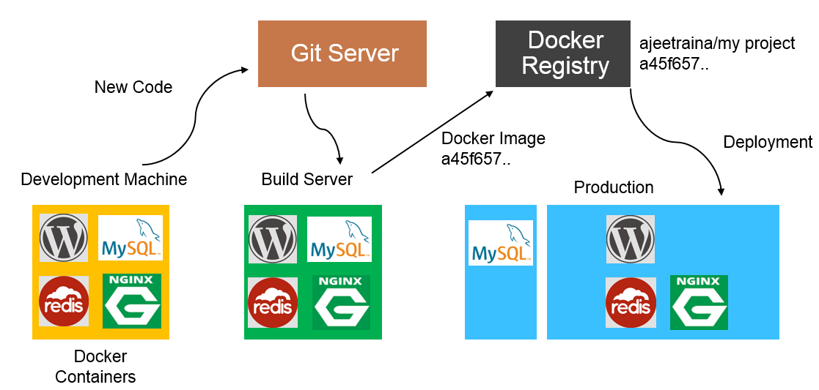

Slide 44
Docker Vs VM

Slide 45
Docker Containers are NOT VMs

Slide 46
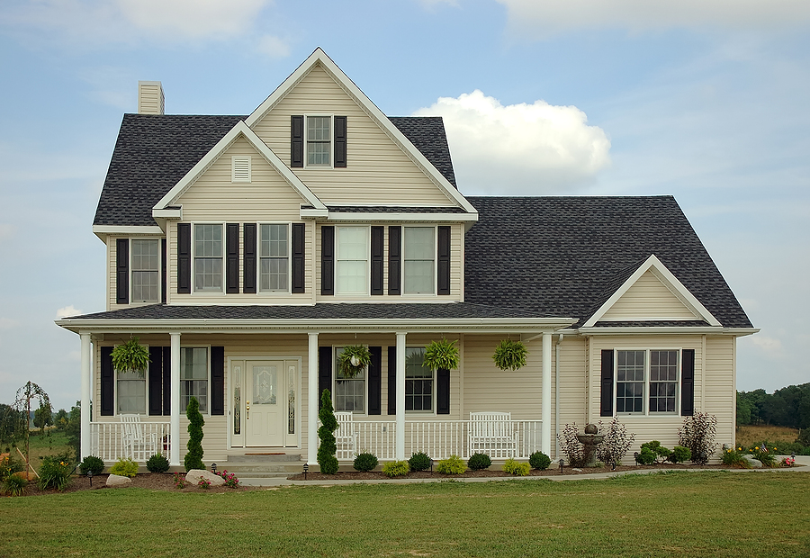
Virtual Machine

Slide 47
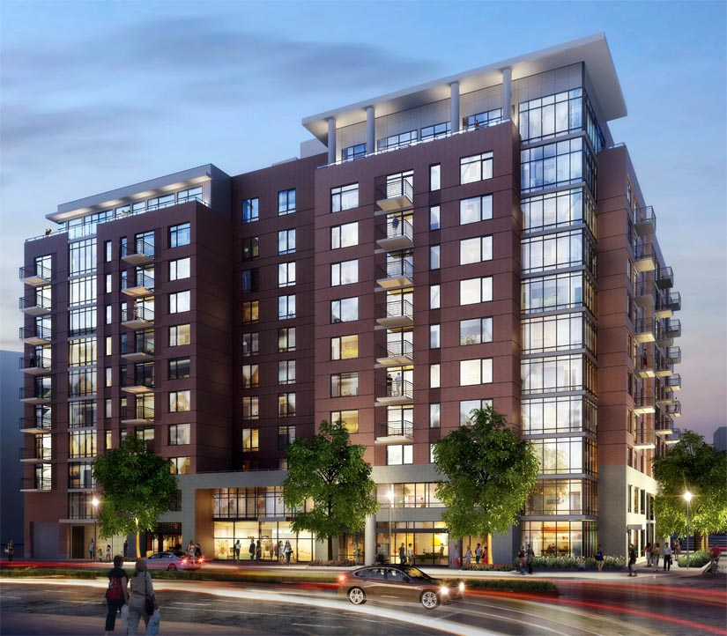
Containers

Slide 48
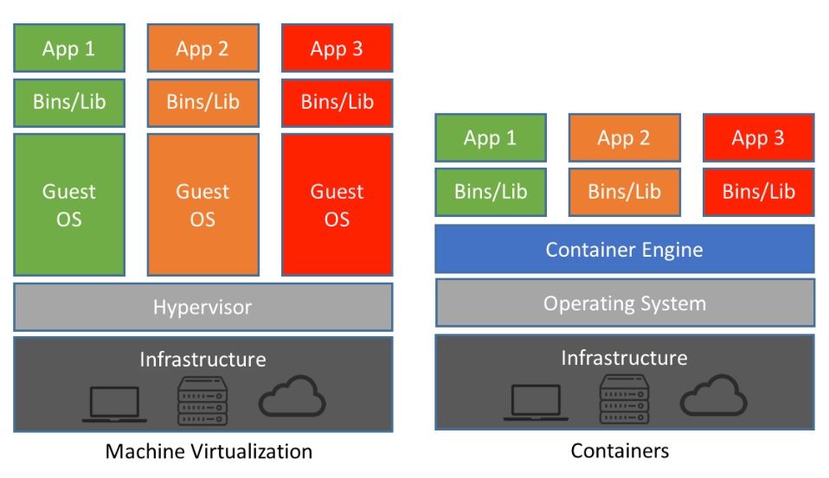
Docker Container Vs VM
Notes:
A container is similar to an application, which runs as a process on top of the operating system(OS) and isolates with each other by running in its own address space. Nevertheless, more than a normal process, a container not only includes the application executable, but also packs together all the necessary softwares that the application needs to run with, such as the libraries and the other dependencies. Cgroups [6] and namespaces [7] are two particular features that enables different containers running on the same physical machine. Cgroups, also named as control groups, is a Linux kernel mechanism to control the resources allocation. It allows

Slide 49
Comparing Docker & VM
Virtual Machines | Docker
Each VM runs its own OS | Container is just a user space of OS
Boot up time is in minutes | Containers instantiate in seconds
VMs snapshots are used sparingly | Images are built incrementally on top of another like layers. Lots of images/snapshots
Not effective diffs. Not version controlled | Images can be diffed and can be version controlled. Docker hub is like GITHUB
Cannot run more than couple of VMs on an average laptop | Can run many Docker containers in a laptop.
Only one VM can be started from one set of VMX and VMDK files | Multiple Docker containers can be started from one Docker image

Slide 50
Docker Vocabulary

Slide 51
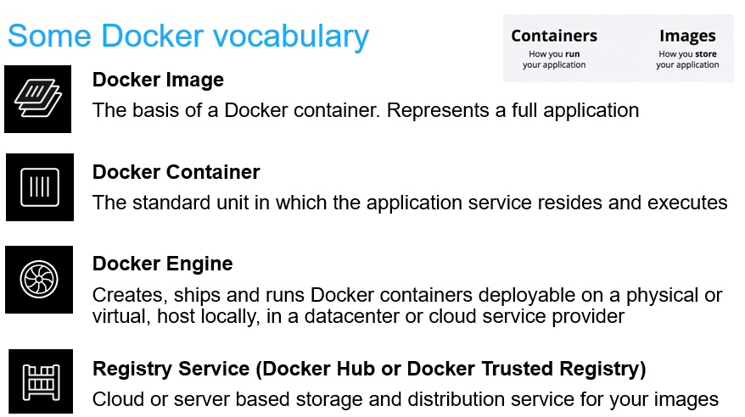

Slide 52
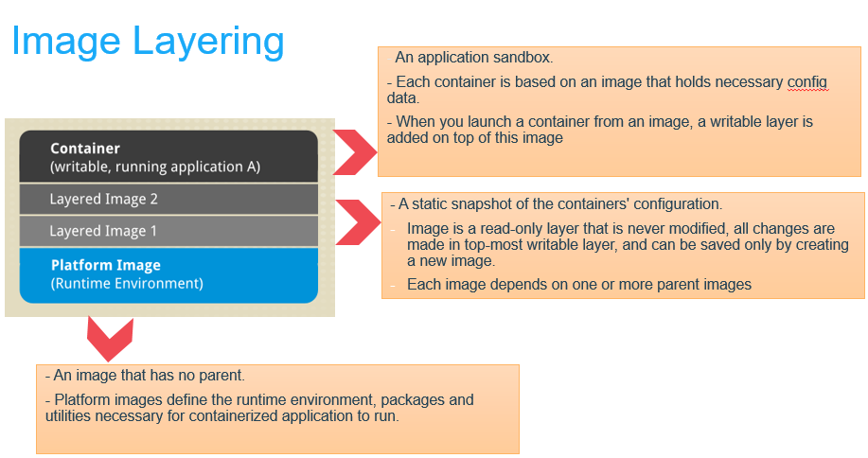

Slide 53
Image Layers
…
Install Requirements
Copy Requirements
Upgrade Pip
Install Python and Pip
Alpine Linux
Kernel

Slide 54
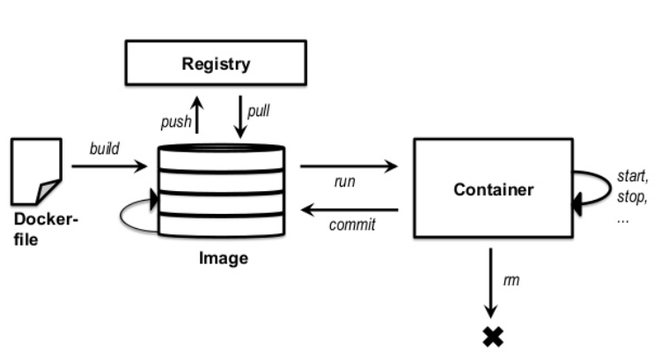
Basic Docker CLIs
Pulling Docker Image
$ docker pull ajeetraina/hellowhale
Listing out Docker Images
$ docker image ls
Running Docker Containers $ docker run –d –p 5000:5000 –-name hellowhale ajeetraina/hellowhale
Stopping the container
$ docker stop hellowhale (or <container id>)

Slide 55
Using Docker – Build, Ship & Run WorkFlow

Slide 56
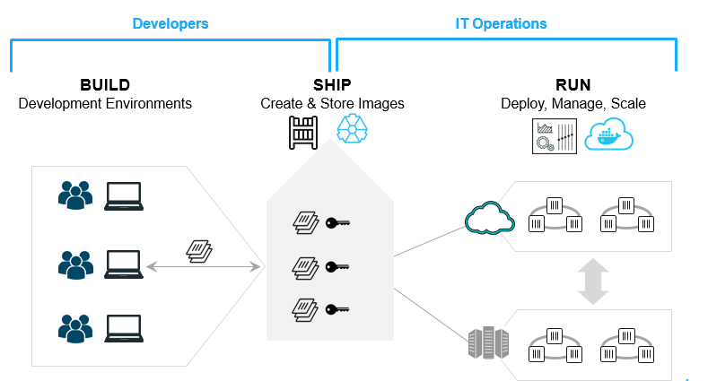
Build. Ship. Run.

Slide 57
Create DockerHub Account(if not completed)
Open https://play-with-docker.com
Hello Whale Example
Build Your First Docker Image & Push it to DockerHub
Demo

Slide 58
Building Docker Containers & Microservices

Slide 59
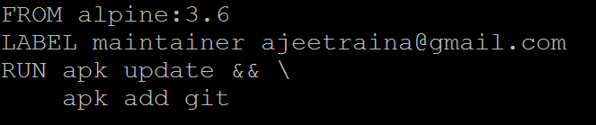
Introducing Dockerfile
Series of instructions to build Docker Images
Notes:
A Dockerfile is a text document that contains all the commands a user could call on the command line to assemble an image
Docker builds images automatically by reading the instructions from a Dockerfile

Slide 60
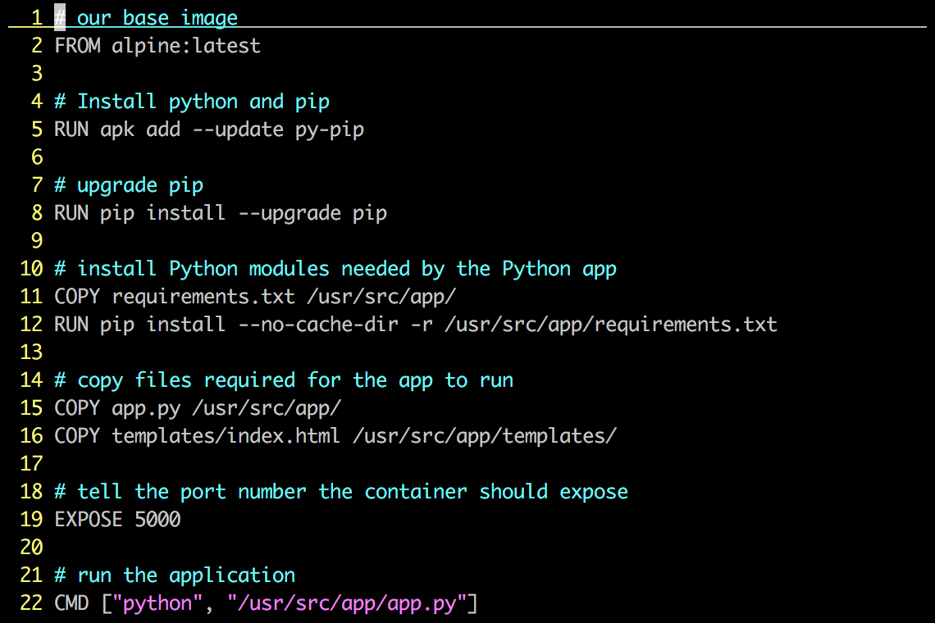
Dockerfile – Example

Slide 61
Each Dockerfile creates a Layer
…
Install Requirements
Copy Requirements
Upgrade Pip
Install Python and Pip
Alpine Linux
Kernel

Slide 62
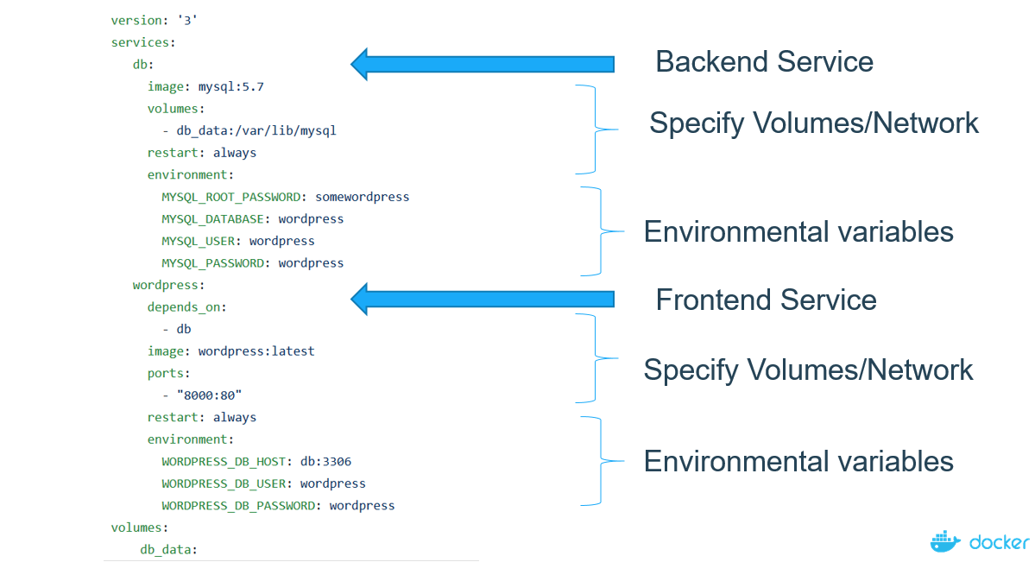
Docker Compose
Compose is a tool for defining and running multi-container Docker applications
Notes:
Compose is a tool for defining and running multi-container Docker applications

Slide 63
Demo
- Running WordPress Application using Docker Compose

Slide 64
Workshop
https://collabnix.github.io/dockerlabs/

Slide 65
References
https://github.com/collabnix/dockerlabs
https://docs.docker.com
https://collabnix.com

Slide 66



Thank You

